Slide 1
Supplier Quality Management
Chapter 8

Slide 2
Chapter Overview
Case study: Strategic quality failure in Global SCM
Overview of supplier quality management
Factors affecting supply management’s role in managing supplier quality
Supply quality management using a TQM perspective
Process capability
Cost of quality
Pursuing Six Sigma supplier quality
Using ISO and the MBNQA criteria

Slide 3
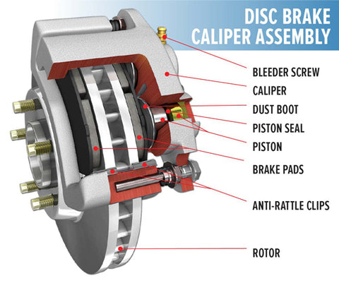
Case Study: Alpha Motors
Strategic Supplier Quality Failure in Global Sourcing
Alpha Motors (a global automotive OEM) sources nearly 65% of its components from external suppliers across Asia and Eastern Europe.
To improve cost competitiveness, Alpha Motors’ procurement team decided to outsource brake caliper components to a new supplier, Sigma Components Ltd., located in a low-cost country, because it offered:
18% lower unit cost
Acceptable initial quality reports
ISO 9001 certification
Based mainly on cost savings and short-term financial targets, Sigma was awarded a single-source contract for three years.

Slide 4
Case Study: Alpha Motors
The Problem: Within 12 months of production
Defect rates increased from 0.8% to 4.5%
Assembly line stoppages became frequent
Customer complaints related to braking noise and performance increased
Two regional markets initiated safety investigations
Although Sigma met contractual delivery volumes, process variation and weak continuous improvement capabilities were identified during audits.

Slide 5
Case Study: Alpha Motors
Procurement’s Dilemma: Alpha Motors faces a strategic decision.
Terminate the contract
  Risk of supply disruption
  Higher short-term costs
Develop the supplier
  Invest time, resources, and training
  No guaranteed improvement
Dual-source
  Increase complexity
  Reduce dependency risk

Slide 6
Case Study: Alpha Motors
Think: What Went Wrong at Alpha Motors?
Overemphasis on cost-based sourcing:
Weak supplier capability assessment
Absence of supplier development strategy: Trainings
Poor quality governance in outsourcing decisions: No system to monitor

Slide 7
What Is Supplier Quality?
The ability to meet or exceed current and future customer expectations or requirements within critical performance areas on a consistent basis
Keys to supplier quality:
  Meet or exceed
  Current and future requirements
  On a consistent basis

Slide 8
Supplier Quality Concerns
Supplier impact on quality:
Continuous improvement
Outsourcing of purchase requirements: Depending on suppliers because of limited resources.

Slide 9
6 Factors: Supply Management’s Role
Supply management does not control quality directly; it enables or limits it through strategic decisions.
The ability of a supplier to affect a buyer’s total quality, e.g., Packaging vs Brake Supplier
2. The resources available to support supplier quality improvement: Time, cost,
3. Ability of a buying firm to practice world-class quality

Slide 10
Factors: Supply Management’s Role
4. A supplier’s willingness to work jointly with the buyer to improve quality
5. A supplier’s current quality levels
6. A buyer’s ability to collect and analyze quality-related data

Slide 11
A TQM Perspective
Defining quality in terms of customers and their requirements
Deming’s 14 Points
Pursuing quality at the source
Stressing objective measurement and analysis
Emphasizing prevention rather than detection of defects

Slide 12
A TQM Perspective
Focusing on process rather than output
Basics of process capability
Striving for zero defects
Cost of quality: Cost of quality is NOT the cost of making a high-quality product. It is the cost of doing things right and wrong.
Establishing continuous improvement as a way of life
Making quality everyone’s responsibility

Slide 13
Quality: The Customer’s Perspective
Nonconforming supplier quality is often due to inconsistent communication and resultant misunderstanding of specifications, expectations, and requirements within the supply chain
  Need for clear specifications and performance requirements
  Sharing of final product requirements

Slide 14
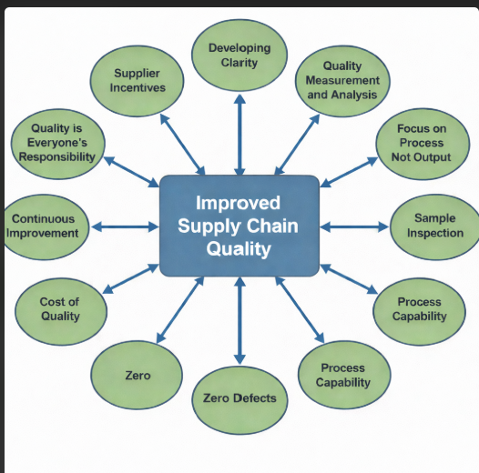
Quality Concepts in SCM

Slide 15
Developing Clarity
Ability of the buying company to briefly identify, clearly define, quantify, or specify its technical and sourcing requirements.
Buyer’s ability and initiative to effectively communicate these requirements to the supplier

Slide 16
Quality at the Source
Doing quality right where the work is done—so defects are prevented, not detected later. Product and process design
  Early supply management involvement (ESMI)
  Early supplier design involvement (ESDI)

Slide 17
Objective Measurement and Analysis
Make decisions on facts, not feelings
Need for a rigorous evaluation system
  Provide feedback to support corrective action
  Track results from improvement initiatives

Slide 18
Prevention of Nonconformance
Need for process consistency
Reduce process variation
Reduce reliance on appraisal, inspection, and detection activities
Use of corrective action requests

Slide 19
Focus on Process, Not on Output
Move from product orientation to process orientation
Quality processes → quality output
Supplier must provide evidence of process capability
Structured, companywide supplier evaluation and selection system

Slide 20
Focusing on Sample Inspections
What supplier would knowingly submit a poor sample?
How many parts did the supplier produce to get an acceptable sample?
Are the samples representative of the process under normal conditions?

Slide 21
Focusing on Sample Inspections
Did the supplier use the same process, methods, and materials that will be used in normal production?
Or was the sample made under controlled laboratory conditions?
Did the supplier actually produce the sample or use a subcontractor?
Do the samples show evidence of capacity or process capability?

Slide 22
Basics of Process Capability
Process capability is the ability of a process to generate outputs that meet engineering specifications or customer requirements
Outputs must fall between pre-established upper and lower specification limits
No special causes of variation exist in the process

Slide 23
Basics of Process Capability
99.73% of all output fall between ± 3 standard deviations of the process mean
A stable process and in statistical control can be expected to produce virtually all of its output within these natural tolerance limits
A process’s natural limits must fall within specification limits to be capable

Slide 24
Process Capability
(a)
(b)
Specification
Specification
Natural Variation
Natural Variation
(c)
(d)
Specification
Specification
Natural Variation
Natural Variation
Source:
MANAGING FOR QUALITY AND PERFORMANCE EXCELLENCE, 7e, © 2008
Evans and Lindsay - Thomson South-Western

Slide 25
Zero Defects
Conformance to requirements (Crosby)
Key metrics to identify improvement opportunities
Supply base rationalization and optimization
  Average supplier quality improves as lower performers are eliminated from the supply base

Slide 26
Cost of Quality
Appraisal costs
  Direct costs of measuring quality
Failure costs
  Internal – occur before product or service is provided to customer
  External – occur following production or after customer takes possession
Prevention costs
  Prevent defects from occurring

Slide 27
Appraisal Cost Examples
Laboratory testing of samples
Inspection activities during production
Supplier quality audits
Incoming material inspections
Other forms of monitoring

Slide 28
Internal Failure Cost Examples
Troubleshooting
Re inspection following detection of defects
Production downtime caused by defects
Scrap
Process waste

Slide 29
External Failure Cost Examples
Warranty costs
Replacement of defective products
Product liability lawsuits
Loss of customers

Slide 30
Prevention Cost Examples
Quality planning
Equipment calibration
Quality training
Maintenance of a quality management system

Slide 31
Continuous Improvement
Value analysis/value engineering (VA/VE)
Supplier development
Supply base rationalization and optimization
Supplier incentive and reward systems

Slide 32
Supplier Incentives
Longer-term contracts
Higher share of purchase volume
Public recognition and awards
Shared cost savings
Access to new technology from buyer
Early insight to new business opportunities and product development plans

Slide 33
Supplier Incentives
Early participation in new product and process development projects
Use of buyer’s supply agreements to obtain favorable pricing
Participation in executive buyer-supplier councils
Listed as preferred supplier with first opportunity for new business

Slide 34
Quality: Everyone’s Responsibility
Aligned vision and goals
Physical co-location
Executive-level buyer-supplier councils
Shared technologies
Joint projects
More collaborative buyer-supplier relationships

Slide 35
Six Sigma Quality
Proven quality principles and techniques
Virtually error-free business performance
Expressed as 3.4 errors (or defects) per million opportunities (DPMO)
Increasing expectations from customers
Focus on defect prevention, cycle time reduction, and cost savings
Use of Six Sigma Black Belts

Slide 36
The DMAIC Model
Define
Measure
Analyze
Improve
Control

Slide 37
The DMAIC Model
Define improvement activity and goals
Measure existing system, establish metrics, and identify performance baseline
Analyze system and develop hypotheses
Improve – develop ideas, test solutions, and implement new process, structure, and system
Control – measures and procedures to ensure system stays in control

Slide 38
Using ISO and MBNQA Criteria
Widely accepted quality management frameworks
  ISO 9000:2000
  ISO 14000
  Malcolm Baldrige National Quality Award
Criteria are often used as the basis for supplier certification programs

Slide 39
ISO 9000:2000
Originally developed in the European Common Market in 1987
Updated in 1994 and 2000
Expected to be updated again in 2008
Third-party registration process
Internationally accepted and recognized quality process standards

Slide 40
Eight Principles of ISO 9000:2000
Customer focus
Leadership
Involvement of people
Process approach
System approach to management
Continual improvement
Factual approach to decision-making
Mutually beneficial supplier relationships

Slide 41
Buyer’s Benefits of ISO 9000:2000
Few firms have sufficient resources to develop and implement their own comprehensive supplier certification audits
Supplier assumes responsibility for meeting the ISO 9000:2000 standards and paying its own registration fees
Supplier demonstrates higher quality

Slide 42
ISO 14000
Established in 1993 to promote environmental protection and pollution prevention
Used to analyze a supplier’s ability to proactively manage its environmental impact
Range from environmental management systems to addressing auditing, labeling, and product standards

Slide 43
ISO 14000
Set of voluntary standards
Classifications
  Process-oriented standards
  Product-oriented standards
But, it does not:
  Build on existing governmental regulations
  Establish emissions and pollution levels
  Detail any specific testing methods

Slide 44
Benefits of ISO 14000
Fewer pollutants generated
Reduced liability risk
Improved regulatory compliance
Better public and community relations
Lowered insurance premiums
Enhanced profitability through:
  Improved resource management
  Reduced waste generation

Slide 45
The MBNQA
Established in 1987
A de facto definition of TQM and competitive set of criteria
More comprehensive set of quality-related criteria than ISO 9000:2000
Implies that an organization excels not only in quality management but also in quality achievement

Slide 46
The MBNQA
Much of current application is for internal use as a quality management tool and not for award purposes
May take 8 – 10 years to adequately prepare a competitive quality system
Built upon a continuous improvement philosophy
Both process and results oriented

Slide 47
MBNQA Criteria Items
Leadership
  Organizational leadership
  Public responsibility and citizenship
Strategic planning
  Strategy development
  Strategy deployment
Customer and market focus
  Customer and market knowledge
  Customer satisfaction and relationships

Slide 48
MBNQA Criteria Items
Information and analysis
  Measurement of organizational performance
  Analysis of organizational performance
Human resource focus
  Work systems
  Employee education, training, and development
  Employee well-being and satisfaction

Slide 49
MBNQA Criteria Items
Process management
  Product and service processes
  Support processes
  Supplier and partnering processes
Business results
  Customer focused results
  Financial and market results
  Human resource results
  Supplier and partner results
  Organizational effectiveness results

Slide 50
Supplier Certification at Alcoa
Meet and Plan
The Supplier Self-Survey
Strategy Planning
The Trial Audit
The Formal Audit
Recommendation Review

